Slide 1
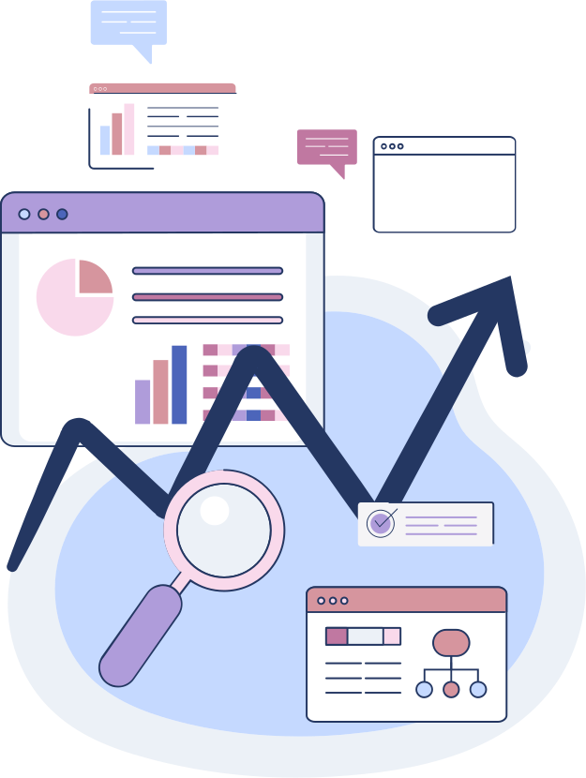
Centralized Retail Performance Dashboard - RetailVue

Slide 2
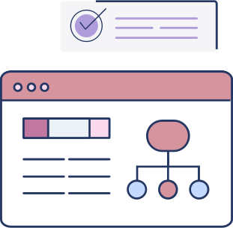
Team Details
Prathyusha Parameshwar Ganiga - 287617
Prerana Joshi - 287640
Trainer
Sharath Kumar

Slide 3

Agenda
Problem Statement
Journey
Tech Stack
Features
Flow Diagram
Challenges
Future Implementation
Project Demo
Final Slide

Slide 4
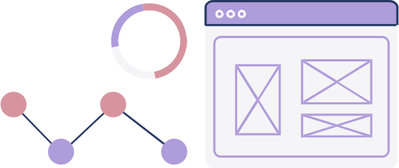
Problem Statement
A growing retail business that operates across multiple regions faces challenges in tracking its sales performance. They rely on multiple platforms for transactions, making it difficult to consolidate sales data, monitor customer behavior, and predict future trends. The company needs a solution that offers a real-time, centralized system to visualize key metrics, track performance across regions, and provide insights for informed decision-making.

Slide 5

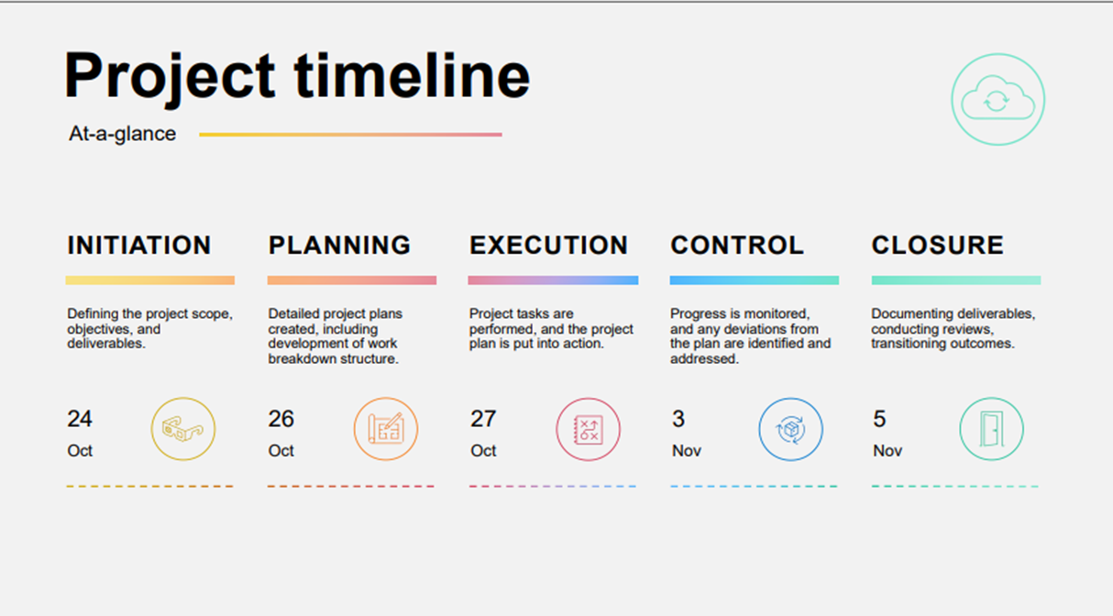
Journey

Slide 6
Tech Stack
Frontend: Express, React with TypeScript, TailWind.css, Figma
Backend: Node with TypeScript
Database: MongoDB Atlas
Authentication: JWT

Slide 7




Features
Business Retailer
Branch Retailer
Sales Rep
Create Order
Invoice Generation
Can add a Branch
View Branch Details
View overall analytics
Restock products
View Analytics according to Branch

Slide 8
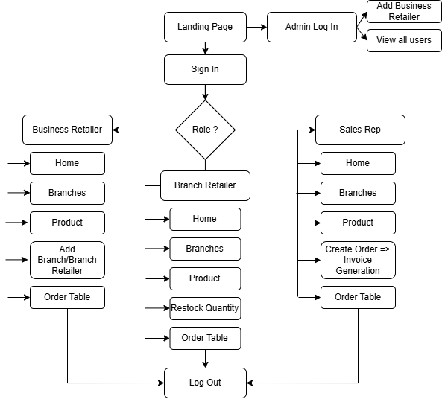
Flow Diagram

Slide 9
Challenges
Data separation based on branches.
Designing analytics according to each branch

Slide 10
Future Implementation
Adding more analytics
Integration of live data.

Slide 11

PROJECT DEMO

Slide 12
Conclusion
In conclusion, implementing a centralized, sales tracking and analytics platform addresses the key challenges faced by the retail business in consolidating sales data across multiple regions and platforms. This comprehensive approach not only streamlines data integration but also facilitates scalability, helping the company prepare for future growth.

Slide 13

THANK YOU

